Slide 1
Heisenberg Ladder: Onset of Diffusion
Kevin Wang, Joel Moore

Slide 2
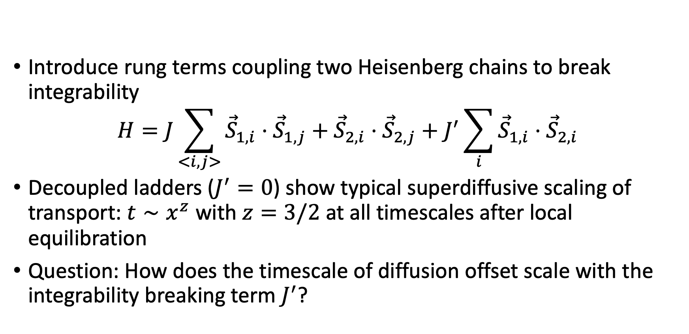
Heisenberg ladder
Introduce rung terms coupling two Heisenberg chains to break integrability
$$H=J\sum_{<i,j>}{{\vec{S}}_{1,i}}⋅{\vec{S}}_{1,j}+{\vec{S}}_{2,i}⋅{\vec{S}}_{2,j}+J^{′}\sum_{i}{{\vec{S}}_{1,i}⋅{\vec{S}}_{2,i}}$$
Decoupled ladders ($J^{′}=0$) show typical superdiffusive scaling of transport: $t∼x^{z}$ with $z=3/2$ at all timescales after local equilibration
Question: How does the timescale of diffusion offset scale with the integrability breaking term $J^{′}$?

Slide 3
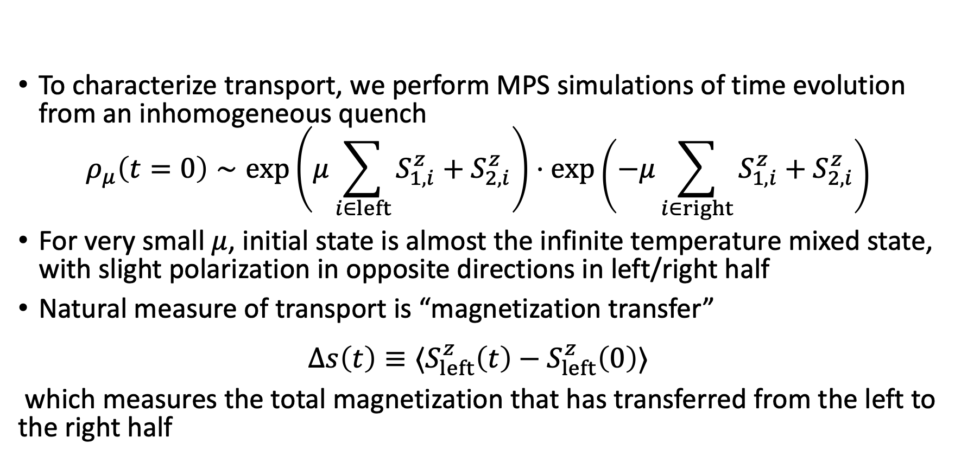
MPS Simulations
To characterize transport, we perform MPS simulations of time evolution from an inhomogeneous quench
$$ρ_{μ}\left(t=0\right)∼\exp\left(μ\sum_{i∈left}{{S_{1,i}^{z}+S}_{2,i}^{z}}\right)⋅\exp\left(−μ\sum_{i∈right}{{S_{1,i}^{z}+S}_{2,i}^{z}}\right)$$
For very small $μ$, initial state is almost the infinite temperature mixed state, with slight polarization in opposite directions in left/right half
Natural measure of transport is “magnetization transfer”
$$Δs\left(t\right)≡⟨S_{left}^{z}\left(t\right)−S_{left}^{z}\left(0\right)⟩$$
which measures the total magnetization that has transferred from the left to the right half

Slide 4
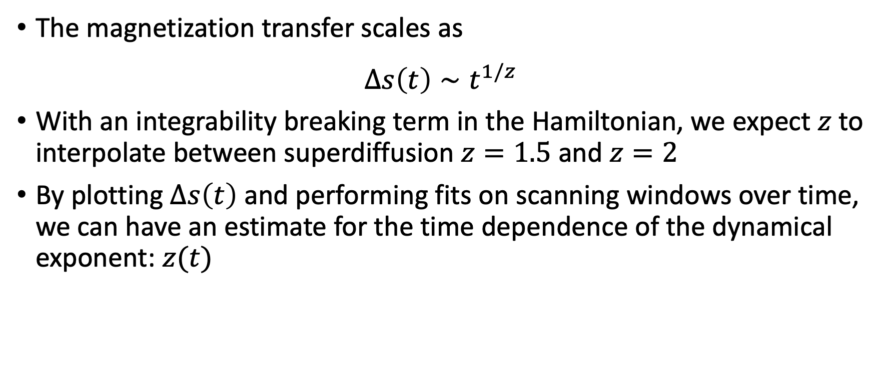
MPS Simulations
The magnetization transfer scales as
$$Δs\left(t\right)∼t^{1/z}$$
With an integrability breaking term in the Hamiltonian, we expect $z$to interpolate between superdiffusion $z=1.5$ and $z=2$
By plotting $Δs\left(t\right)$ and performing fits on scanning windows over time, we can have an estimate for the time dependence of the dynamical exponent: $z(t)$

Slide 5
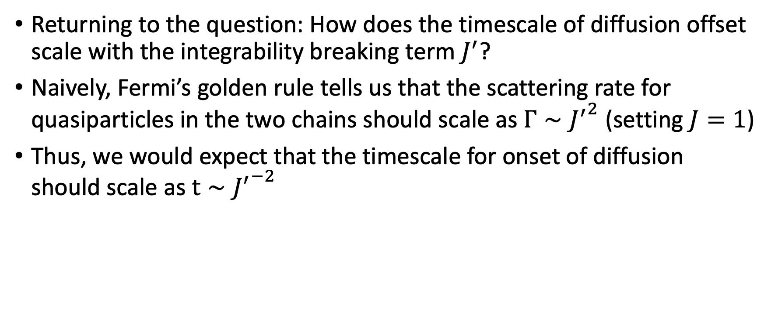
Fermi’s Golden Rule
Returning to the question: How does the timescale of diffusion offset scale with the integrability breaking term $J^{′}$?
Naively, Fermi’s golden rule tells us that the scattering rate for quasiparticles in the two chains should scale as $Γ∼{J^{′}}^{2}$ (setting $J=1$)
Thus, we would expect that the timescale for onset of diffusion should scale as $t∼{J^{′}}^{−2}$

Slide 6

Plotting $Δs(t)$ and $z(t)$ from MPS simulations

Slide 7
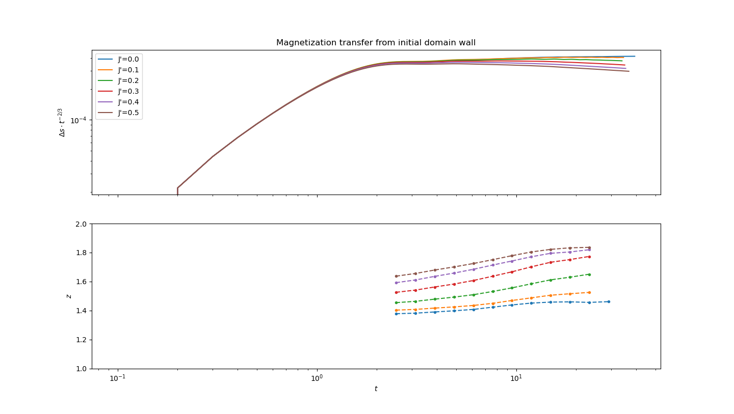

Slide 8

Rescaling time by ${J^{′}}^{2}$

Slide 9
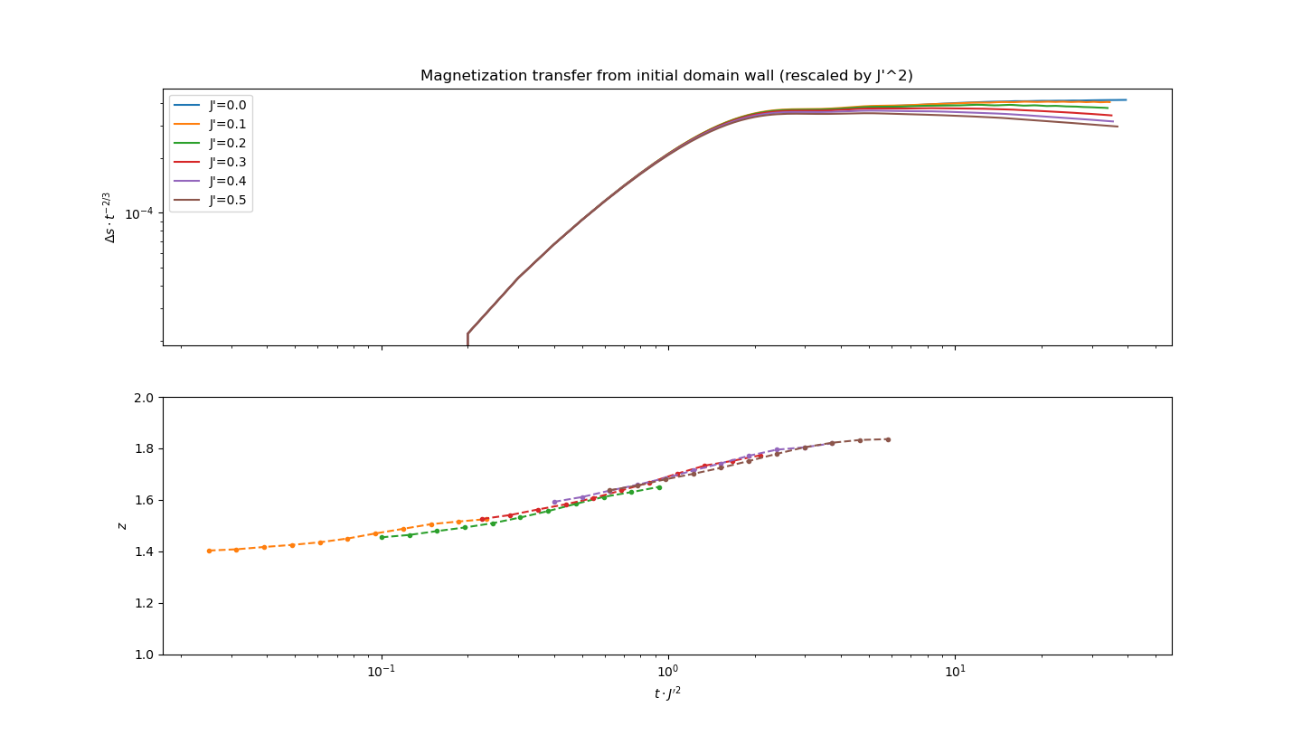

Slide 10
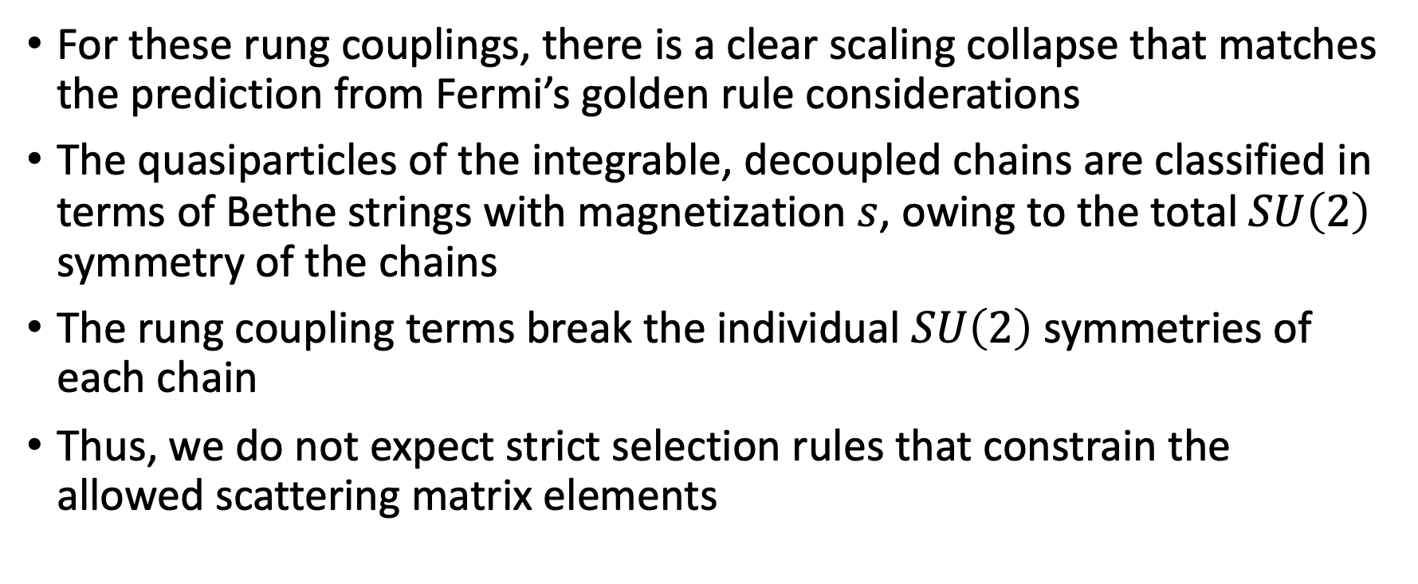
Fermi’s Golden Rule
For these rung couplings, there is a clear scaling collapse that matches the prediction from Fermi’s golden rule considerations
The quasiparticles of the integrable, decoupled chains are classified in terms of Bethe strings with magnetization $s$, owing to the total $SU\left(2\right)$ symmetry of the chains
The rung coupling terms break the individual $SU\left(2\right)$ symmetries of each chain
Thus, we do not expect strict selection rules that constrain the allowed scattering matrix elements

Slide 11
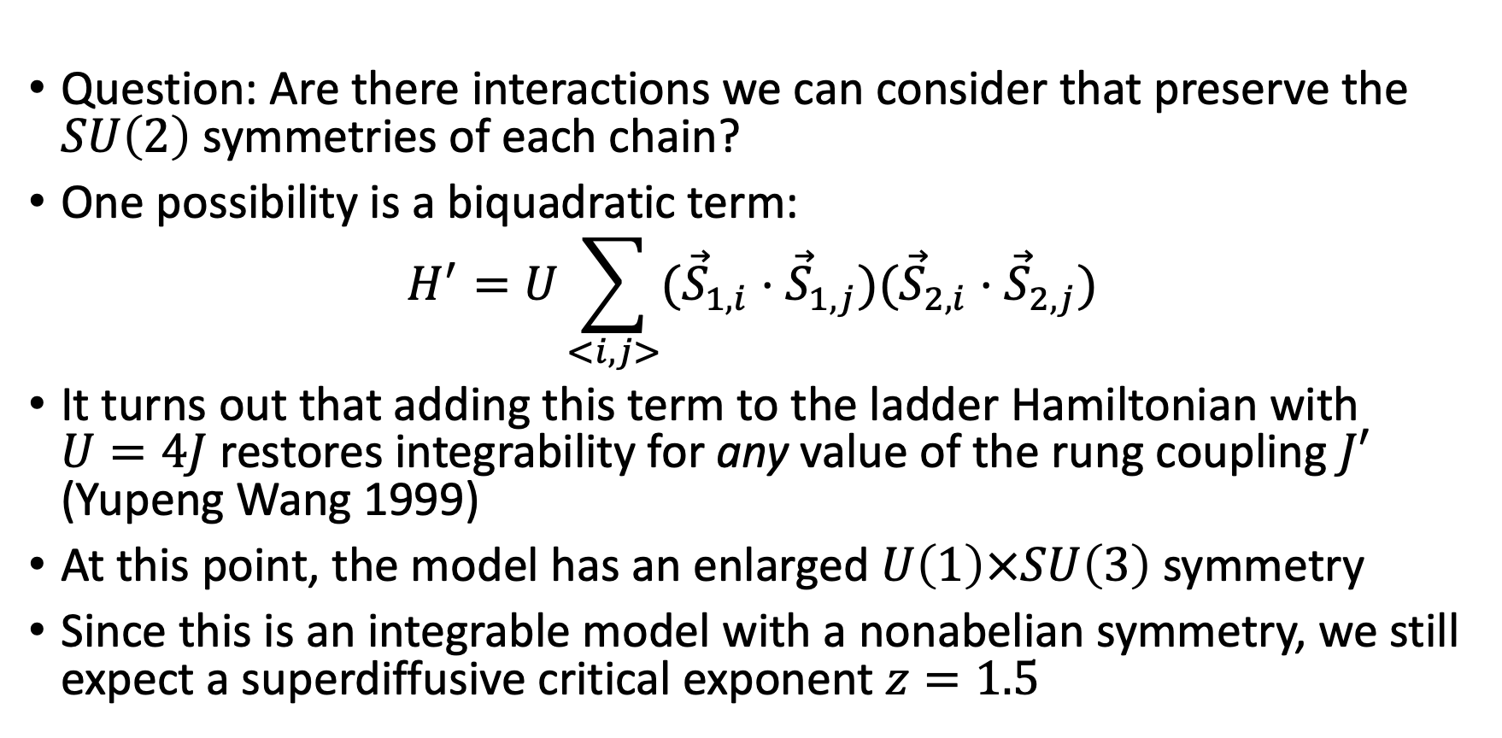
Other Perturbations
Question: Are there interactions we can consider that preserve the $SU\left(2\right)$ symmetries of each chain?
One possibility is a biquadratic term:
$$H^{′}=U\sum_{<i,j>}{({\vec{S}}_{1,i}⋅{\vec{S}}_{1,j})({\vec{S}}_{2,i}⋅{\vec{S}}_{2,j})}$$
It turns out that adding this term to the ladder Hamiltonian with $U=4J$ restores integrability for any value of the rung coupling $J′$ (Yupeng Wang 1999)
At this point, the model has an enlarged $U\left(1\right)×SU\left(3\right)$ symmetry
Since this is an integrable model with a nonabelian symmetry, we still expect a superdiffusive critical exponent $z=1.5$

Slide 12
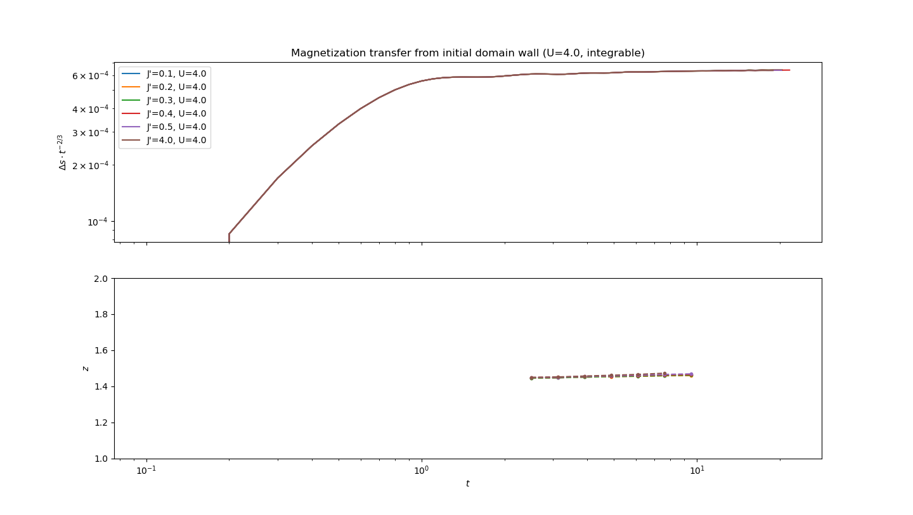

Slide 13
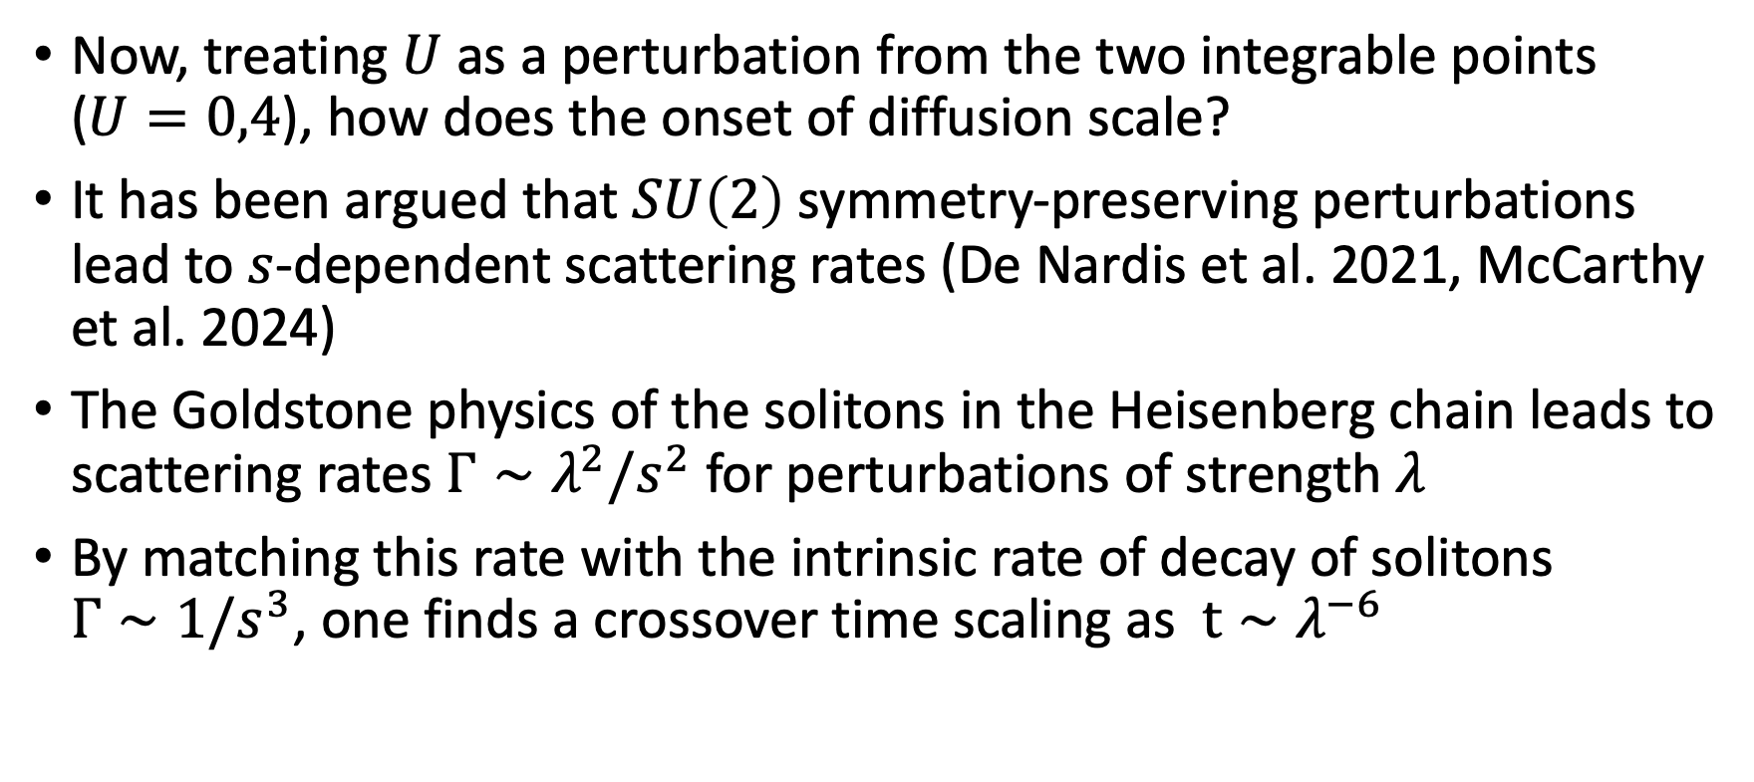
Other Perturbations
Now, treating $U$ as a perturbation from the two integrable points ($U=0,4$), how does the onset of diffusion scale?
It has been argued that $SU\left(2\right)$ symmetry-preserving perturbations lead to $s$-dependent scattering rates (De Nardis et al. 2021, McCarthy et al. 2024)
The Goldstone physics of the solitons in the Heisenberg chain leads to scattering rates $Γ∼λ^{2}/s^{2}$ for perturbations of strength $λ$
By matching this rate with the intrinsic rate of decay of solitons $Γ∼1/s^{3}$, one finds a crossover time scaling as $t∼λ^{−6}$

Slide 14
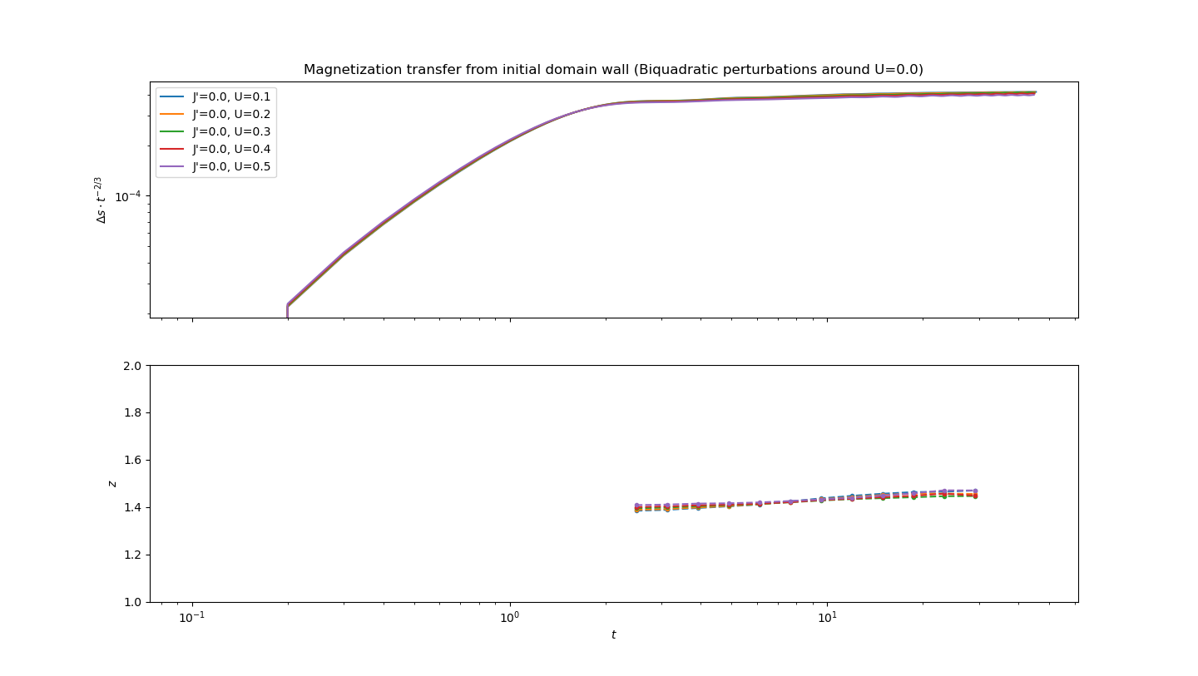

Slide 15
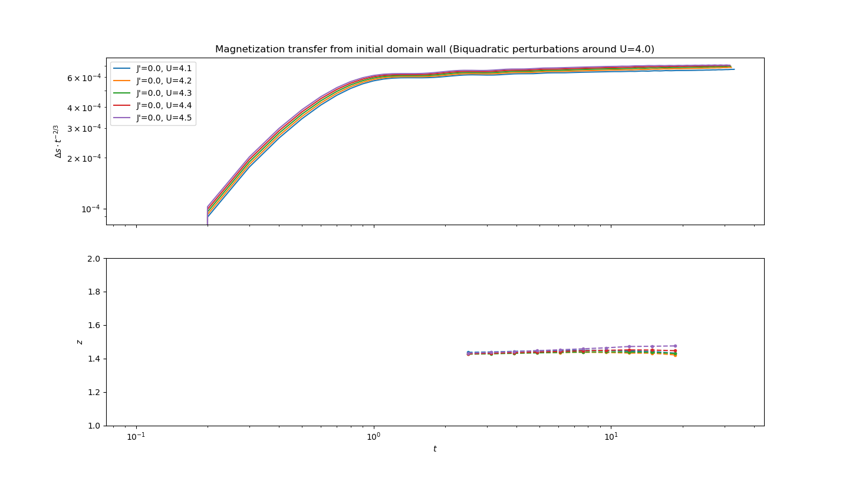

Slide 16
Other Perturbations
These timescales are difficult to access with state-of-the-art MPS techniques
Qualitatively however, one clearly sees that superdiffusion is preserved for much longer timescales as compared to symmetry-breaking perturbations

Slide 17
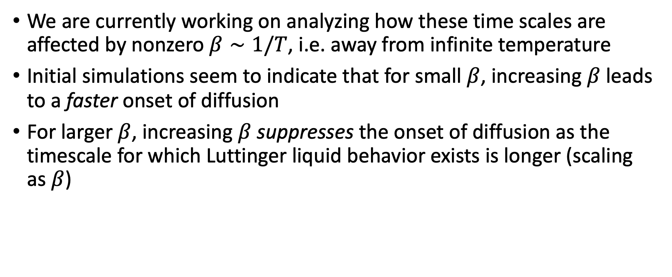
TODO
We are currently working on analyzing how these time scales are affected by nonzero $β∼1/T$, i.e. away from infinite temperature
Initial simulations seem to indicate that for small $β$, increasing $β$ leads to a faster onset of diffusion
For larger $β$, increasing $β$ suppresses the onset of diffusion as the timescale for which Luttinger liquid behavior exists is longer (scaling as $β$)

